Slide 1
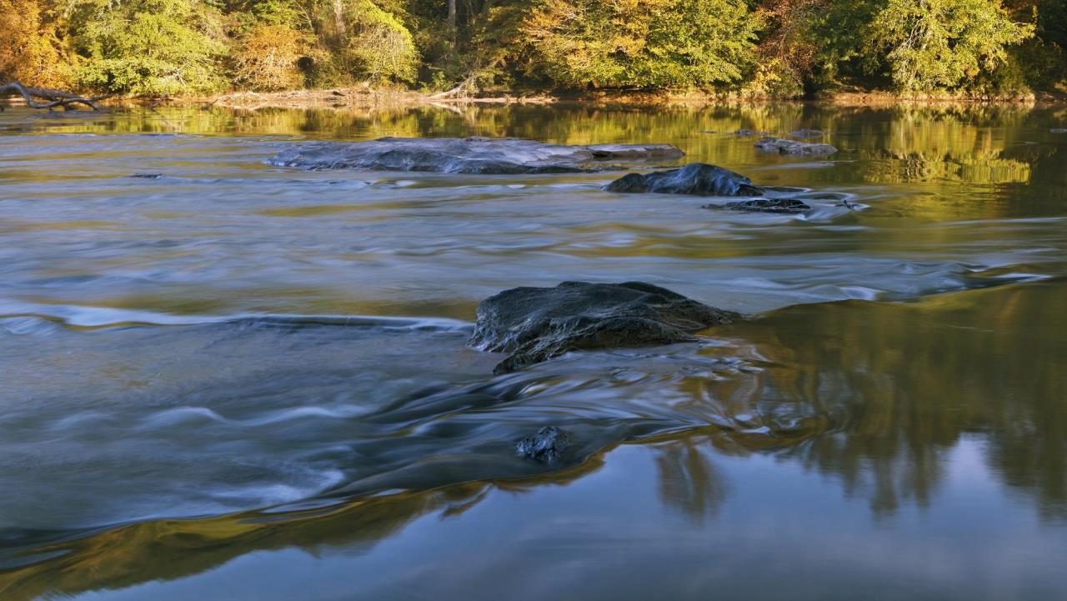


A JOINT VENTURE
Big Creek WRF Expansion
Virtual Progress Update
June 25, 2020

Slide 2
Welcome and Agenda
Welcome and Introduction 6:30 – 6:40
David Clark, Director- Fulton County Department of Public Works
Project Overview 6:40 – 6:55
Kelly Comstock, Design Manager – Archer Western /Brown and Caldwell JV
Construction Overview and COVID 19 Impact 6:55 – 7:10
Pavel Mayfield, Project Manager – Archer Western /Brown and Caldwell JV
Q&A Session 7:10 – 7:30
Open to All

Slide 3




Project Goal and Benefits to Fulton County
Project Goal
Protecting the environment while improving the quality of treated water discharged into the Chattahoochee River and meeting the capacity treatment demands of areas served
Project Benefits
  Increase capacity to meet communities’ needs
  Provide state-of-the-art advanced treatment for reliable compliance with both current and projected future regulations/limits
  Eliminate odor and improve facility aesthetics
  Restore reliability and safety for aging facility

Slide 4
Project Details
Big Creek WRF first constructed in 1971
Several expansions since 1971 – current capacity of 24 million gallons per day (mgd)
Serves Roswell, Alpharetta, Northern Sandy Springs, portions of Milton and Johns Creek, and areas of Cobb and Forsyth Counties
Metropolitan North Georgia Water Planning District forecast - continued population growth and economic development require additional capacity
Initial phased expansion to 32 mgd and ultimately to 38 mgd using state of the art membrane technology and new odor control systems
Replacement of aging equipment and demolition of older and unused facilities
Project will provide capacity through at least 2050

Slide 5
Project Details
Progressive Design Build Approach
  County has been working with the Archer Western / Brown and Caldwell JV team in Implementation
  Completed design to 80% and established the Guaranteed Maximum Price (GMP) for the project
  Initial site preparation (Phase 2A) began in late 2019
  BOC will vote to approve GMP, finish the design and initiate construction on main plant (Phase 2B) in July
  Phase 2B construction will begin this fall
  Phase 2B will be complete in early 2024
Fulton County has secured bond funding for the project

Slide 6
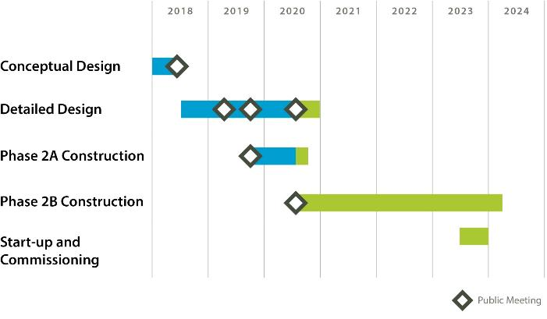
Project Schedule
80% Design of the new facilities has been completed with remaining final design happening this summer / fall
An early grading package (Phase 2A) initiated work in Late 2019 and is nearing completion
Construction of the new plant (Phase2B) will begin this summer and the new facility is expected to be fully operational in late 2023 followed by some additional demolition at the existing plant.

Slide 7
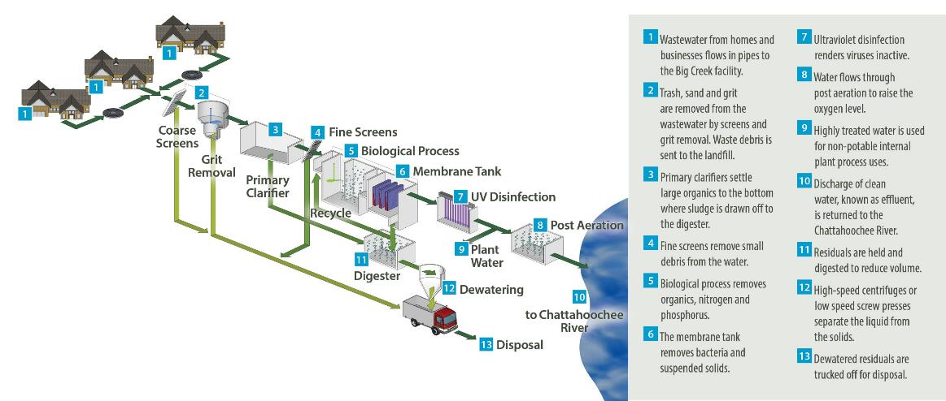
Overall Treatment Process

Slide 8
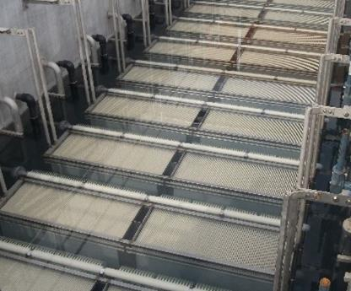
MBR Technology
A membrane bioreactor (MBR) system is an advanced technology used for treating wastewater
The system combines biological treatment/nutrient removal with microfiltration membranes that filter out particles greater than 0.2 um (one thousandth of a millimeter) in diameter. Flat Plate membrane technology provided by KUBOTA was competitively selected for the Big Creek WRF Facility
MBR technology is one of the most advanced treatment technologies in wastewater treatment and has successfully been implemented by Fulton County for over a decade at the Johns Creek Environmental Campus and numerous other facilities around the US and the world
KUBOTA Flat Plate Membranes

Slide 9
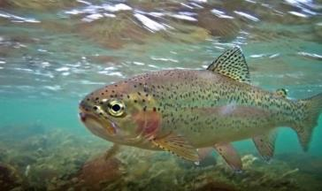
Water Quality Improvements
The new facility will provide greater capacity with significantly reduced load/impact to the Chattahoochee River compared to current permitted levels
The high water quality helps protect the environment
Permitted Levels at 38 mgd
Current Permit Levels at 24 mgd

Slide 10
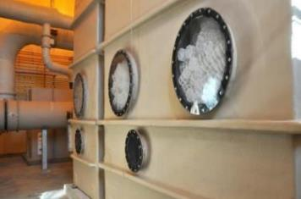
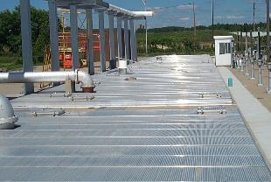
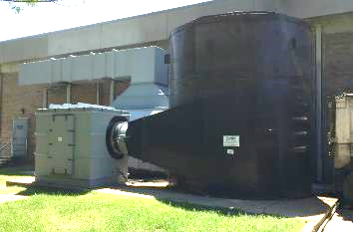
Minimizing Neighborhood Impacts - Odor Control
The new Big Creek WRF will have the following odor control provisions:
Treatment basins will be covered.
Fans connected to the odor control equipment will draw air from under the basin covers so that all air in the basins will be treated by the odor control equipment.
Chemical Scrubber (example installation)
Multi-stage chemical scrubbers followed by Granular Activated Carbon (GAC) for highest odor areas, and GAC for the remainder of potential odorous areas.
Sensors will monitor the air leaving the GAC units to make sure they are working properly.
GAC (example installation)

Slide 11
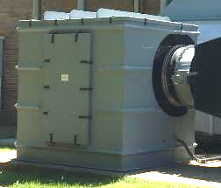
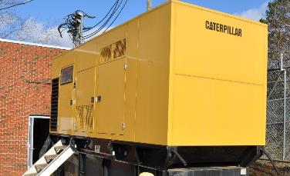

Minimizing Neighborhood Impacts – Noise and Light
The new Big Creek WRF will address noise and light concerns with the following provisions wherever practical:
Locating noise and light sources away from neighbors
Centralizing regular traffic on the site
Using noise reduction enclosures for equipment
Using directional, full cutoff area lighting to limit light emissions offsite
Using lighting controls to limit the use of lighting when not needed
Example Noise Reduction Enclosures
VERY BAD
Minimizing Light Impacts

Slide 12
Design Update
Phase 2A
  Early Site prep package complete, and under construction
Phase 2B
  Dewatering building - progressed to 100% to allow for early construction
  Primary, MBR, BNR, UV slabs - progressed to 100% to allow for early construction
  Remaining design is at 80%, once GMP approved will complete the design to 100%

Slide 13
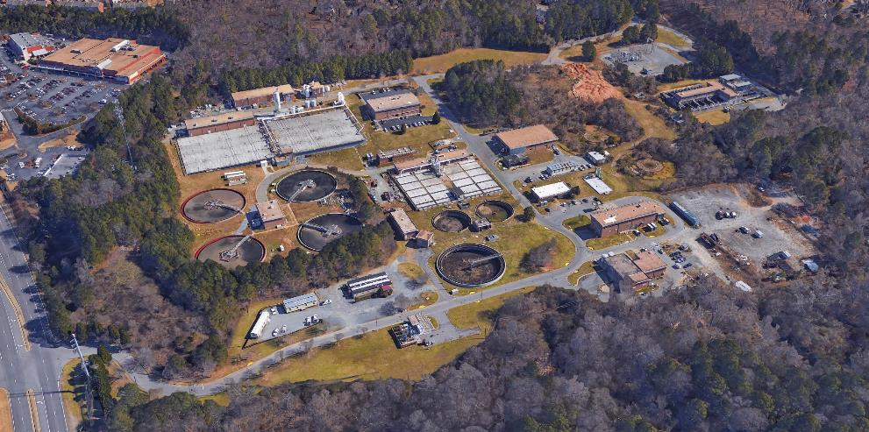
Existing Site Layout
Admin Bldg & Lab
Headworks
Dewatering Bldg
Filters
BNR Tanks
UV & Post Aeration
Secondary Clarifiers
Digesters

Slide 14
Initial Site Preparation (Phase 2A)
In order to increase the speed of implementation and reduce the cost of the overall project, the County has finalized an early sitework project that begin in the fall of 2019. It includes the following:
Establishment of erosion control improvements including storm ponds that will be utilized for construction of the new plant facilities.
Demolition of multiple structures around the site so they are cleared away prior to new construction.
The existing site has a large stockpile of material (dirt, rock, and debris) that has to be excavated, sorted through and backfilled around the site to get to the final grade needed for new facility construction
Relocation of some existing utilities that are located under where new structures will be located.
Installation of foundation piles for dewatering, UV, and membrane gallery.

Slide 15
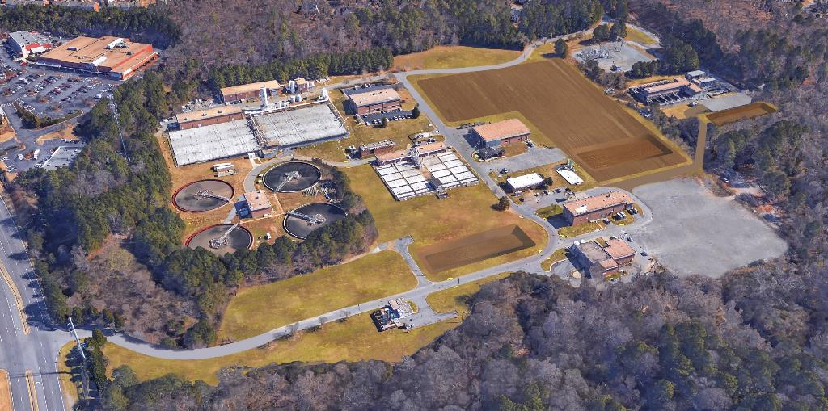
Initial Site Preparation (Phase 2A)

Slide 16
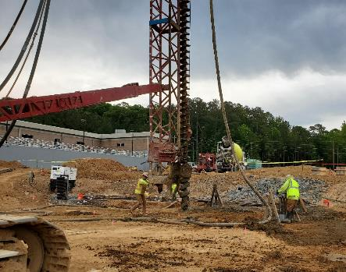
Minimizing Neighborhood Impacts During Construction
During Construction, careful attention is being paid to minimizing impacts to the surrounding community
All construction traffic to the site uses Highway 120 and not Willeo Road. Traffic is not use surrounding neighborhoods to turn around.
Dust and erosion control measures are being employed to protect surrounding streams and reduce impacts to surrounding communities.
Optimized construction schedule is reducing overall project duration.
Management of work hours during construction is being done in accordance with requirements of the City of Roswell.
24-hr hotline has been provided for reporting of any issues. (678) 903-7640
Auger Cast Grout Piles
Ductile Iron Pipe

Slide 17
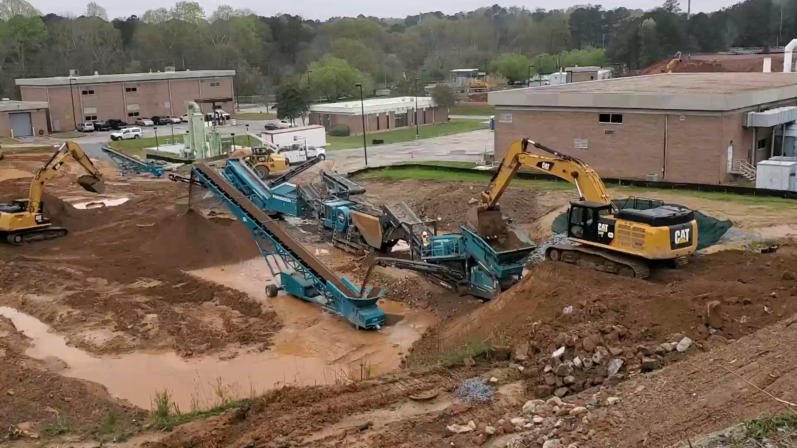
Phase 2A – Earthwork Operation
To reduce incoming/outgoing haul truck traffic, majority of the Earthwork is being be processed onsite.
Crushing and screening equipment utilized to process 150,000 cubic yards of rock and soil to be re-used onsite.

Slide 18
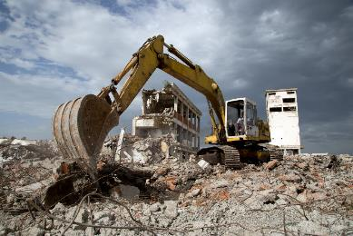
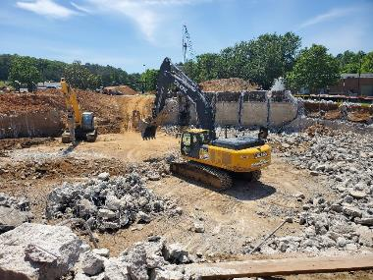
Phase 2A – Demolition Overview
Excavators, bulldozers, and hand-held tools are being used to demolish existing structures on the Big Creek site.
Demolished structures are being crushed offsite to minimize noise and dust pollution.
11 Existing structures are being demolished during Phase 2A.
Hazardous materials have been handled and removed from the site by qualified professionals.

Slide 19
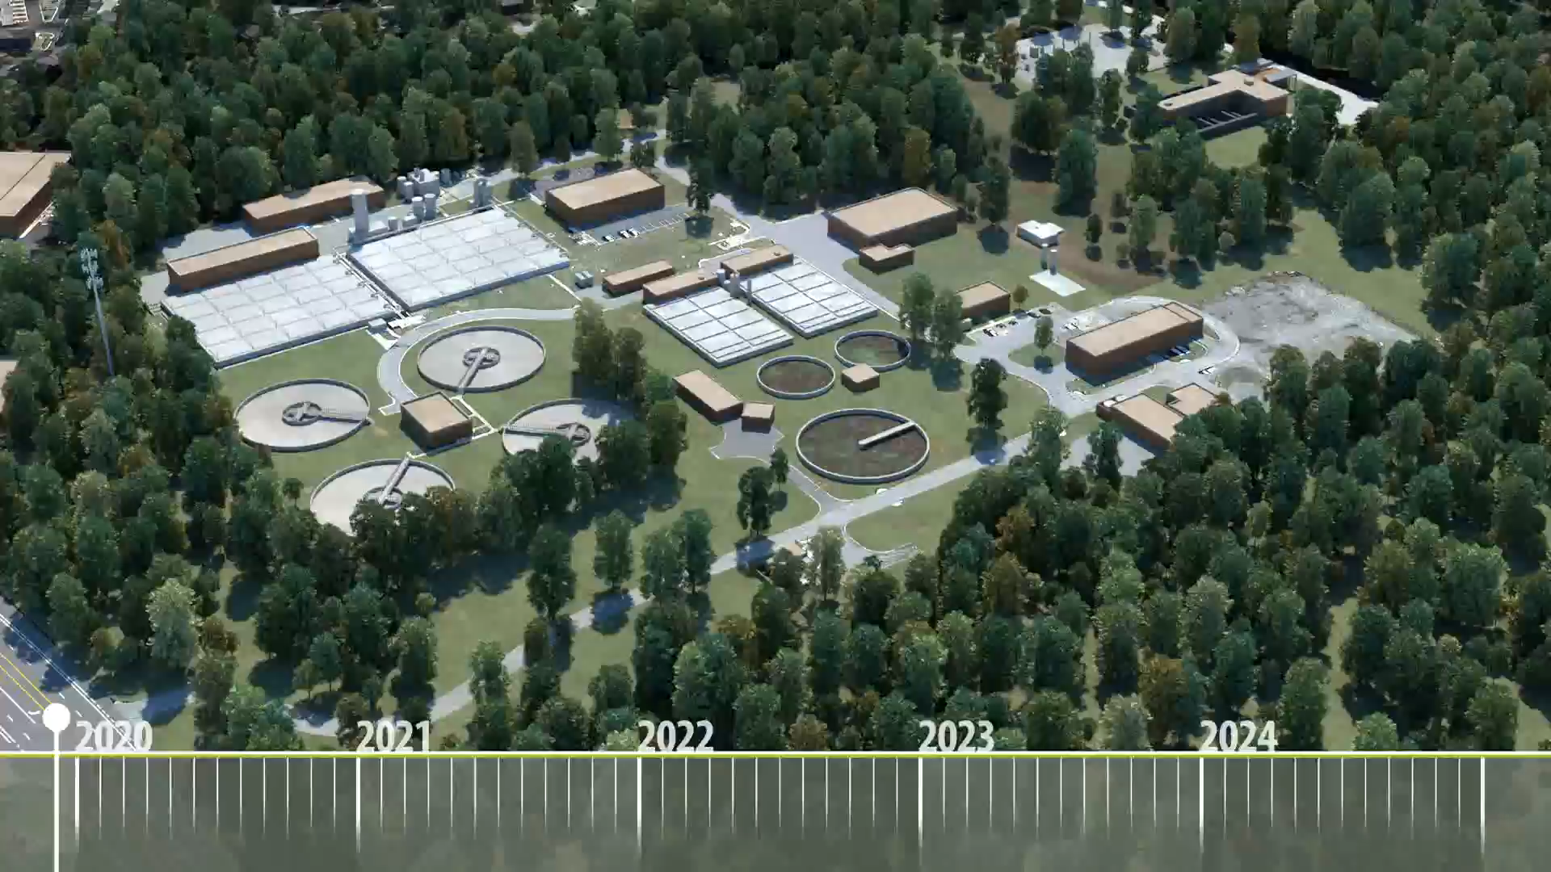
New Facility Construction

Slide 20
Questions and Answers
Additional Project Information Bigcreekexpansion.com
24-hr hotline
(678) 903-7640
Kcomstock@brwncald.com

Slide 21
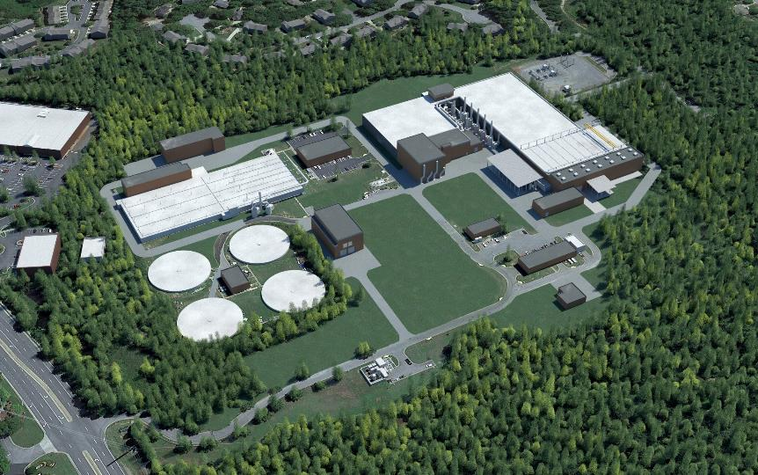
New Facility Layout (Phase 2B)
Fine Screens
Primary Clarifiers
Odor Control
Digesters
BNR Tanks
Lab
MBR Tanks
Headworks
UV & Post Aeration
Equalization Tanks
Dewatering Bldg
Electrical Bldg
Chemical Bldg
Admin Bldg

